Slide 1
Determinants of Perceived Health: Dietary Habits, Socioeconomic Factors, Physical Activity, and Personal Metrics
A 2019 and 2021 SMART BRFSS City and County Data Analysis
By: Obinna Dinneya
Student number: 501217859

Slide 2
INTRODUCTION
This health data project explores the often-overlooked aspect of self-perceived health, delving into why some people feel healthier than others despite similar conditions.
We investigate not just visible factors like diet and exercise but also subtle influences like cultural background and everyday challenges.
This comprehensive approach aims to weave a rich tapestry of perceived health, considering origins, societal contexts, and personal struggles to fully understand well-being."

Slide 3
RESEARCH QUESTIONS
How do dietary habits, specifically the consumption of fruits and green vegetables, relate to overall health outcomes and perceived health predictions?
How does socioeconomic status, emphasizing racial and ethnic backgrounds, influence healthcare access and overall health outcomes?
How does regular physical exercise influence tangible health outcomes, such as the risk of developing cancer, and mental health outcomes, including the likelihood of being diagnosed with depression?
Is there a correlation between Chronic conditions and individuals' self-assessed health status?
Can perceived health be accurately predicted using dietary habits, socioeconomic indicators, lifestyle choices, and individual metrics?

Slide 4
METHODOLOOGY,APPROACH AND TOOLS

Slide 5
METHODOLOOGY,APPROACH AND TOOLS

Slide 6
FINDINGS AND RESULTS
RESEARCH QUESTION 1
How do dietary habits, specifically the consumption of fruits and green vegetables, relate to overall health outcomes and perceived health predictions?
*Wallace et al. (2020): Health Impacts of Fruit & Vegetable Intake
Conducted an umbrella review analyzing recent clinical trials and observational studies.
Findings :
“The scientific evidence for providing public health recommendations to increase F&V consumption for prevention of disease is strong.
Current evidence suggests that F&V have the strongest effects in relation to prevention of CVDs, noting a nonlinear threshold effect of 800 g per day (i.e., about 5 servings a day).” *Not directly Proportional*
A.) Comparison between the daily dark Vegetable Consumption between individuals with perceived good health Vs perceived fair or poor health using statistical analysis.
Unpaired One-sided Sample T-test Results:
Null Hypothesis (H₀):
Mean daily intake of dark green vegetables for those with perceived good health ≤ those with perceived bad health.
Alternative Hypothesis (H₁):
Mean daily intake of dark green vegetables for those with perceived good health > those with perceived bad health.
confidence interval = 95%
pvalue < 0.05(alpha) ; this indicates that we reject the null hypothesis
pvalue < 0.01 this also shows that the results are highly statistically significant

Slide 7
FINDINGS AND RESULTS
RESEARCH QUESTION 1
How do dietary habits, specifically the consumption of fruits and green vegetables, relate to overall health outcomes and perceived health predictions?
*Wallace et al. (2020): Health Impacts of Fruit & Vegetable Intake
Conducted an umbrella review analyzing recent clinical trials and observational studies.
Findings :
“The scientific evidence for providing public health recommendations to increase F&V consumption for prevention of disease is strong.
Current evidence suggests that F&V have the strongest effects in relation to prevention of CVDs, noting a nonlinear threshold effect of 800 g per day (i.e., about 5 servings a day).” *Not directly Proportional*
B.) Comparing the daily fruit Consumption between individuals with perceived good health Vs perceived bad health.
Unpaired One-sided Sample T-test Results:
Null Hypothesis (H₀): Mean daily intake of fruits for those with perceived good health ≤ those with perceived fair or poor health.
Alternative Hypothesis (H₁): Mean daily intake of fruits for those with perceived good health > those with perceived fair or poor health.
confidence interval = 95%
pvalue < 0.05(alpha) ; this indicates that we reject the null hypothesis
pvalue < 0.01 this also shows that the results are highly statistically significant

Slide 8
FINDINGS AND RESULTS
RESEARCH QUESTION 1
*Wallace et al. (2020): Health Impacts of Fruit & Vegetable Intake
Conducted an umbrella review analyzing recent clinical trials and observational studies.
Findings :
“Current evidence suggests that F&V have the strongest effects in relation to prevention of CVDs, noting a nonlinear threshold effect of 800 g per day (i.e., about 5 servings a day).”
*Not directly Proportional*
C.) Do F&V when consumed in quantities around five servings daily, exhibit potent preventive effects against Cardiovascular Disease?
Unpaired One-sided Sample T-test Results:
Null Hypothesis (H₀): Mean total CVD cases for those who eat less than 5 servings of F&V ≤ mean total CVD cases for those who eat 5 or more servings of F&V.
Alternative Hypothesis (H₁): Mean total CVD cases for those who eat less than 5 servings of F&V > mean total CVD cases for those who eat 5 or more servings of F&V.
Confidence interval = 95%
pvalue < 0.05(alpha) ; this indicates that we reject the null hypothesis
pvalue < 0.01 this also shows that the results are highly statistically significant

Slide 9
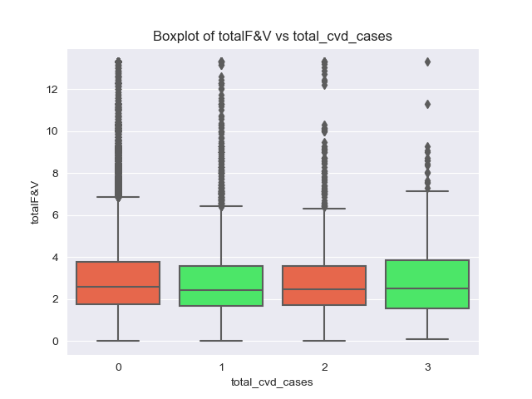
FINDINGS AND RESULTS
Total F&V:
Refers to the total daily consumption of fruits and vegetables
Total CVD Cases represents the total of all cardiovascular diseases that each individual has reported having or had in the past.
CVD:
-Heart Attack or MI
-Angina or CHD
-Stroke

